Slide 1
OSK
STRATEGIC REVIEW · FY2026
[Presentation title goes here in two lines]
[One-sentence framing that previews the answer the audience will hear. Keep it under 25 words.]
PREPARED FOR
PREPARED BY
DATE
STATUS
[Audience / Committee]
[Team / Function]
[Month YYYY]
Strictly Confidential — Draft

Slide 2

IMPORTANT — PLEASE READ
This document is confidential and prepared solely for the named recipients.
[Insert standard legal language: distribution restrictions, forward-looking statements, data sources, and disclaimers. Replace with the wording approved by Legal for this audience.]
CLASSIFICATION
VERSION
OWNER
Strictly Confidential
[v0.1 — Draft]
[Document owner]
02 / 64

Slide 3
AGENDA
What we'll cover in the next [45] minutes
01
Context
Why we are here and what has changed
p. 07
02
Diagnosis
What the analysis revealed about the root cause
p. 14
03
Strategic Options
The choice set and how we evaluated them
p. 21
04
Recommendation
What we propose, why, and the expected impact
p. 26
05
Roadmap
How we will execute over the next four quarters
p. 32
06
Decisions Required
Specific asks of the leadership team today
p. 39
AGENDA
03 / 64

Slide 4
EXECUTIVE SUMMARY
[State the answer in one sentence — what you want them to decide, believe, or do]
THE THREE REASONS
DECISION REQUIRED TODAY
01
[First reason — the most important driver of the recommendation.] [One supporting fact or proof point with a number.]
[State the single, specific decision the leadership team needs to make in this meeting.]
IF WE DON'T ACT
02
[Second reason — supporting evidence the audience will care about.] [Supporting proof point.]
[Concrete consequence of inaction — what is lost, when, and at what scale.]
03
[Third reason — what makes acting now the right choice.] [Supporting proof point.]
IF WE DO
[Concrete outcome of acting now — impact, timing, and order of magnitude.]
EXECUTIVE SUMMARY
04 / 64

Slide 5
KEY MESSAGES
Four things to take away — even if you remember nothing else
01 · CONTEXT
02 · DIAGNOSIS
03 · RECOMMENDATION
04 · ASK
[What has changed in our market or business]
[The root cause we identified]
[The action we propose]
[The specific decision needed today]
[One sentence on the evidence behind it.]
[Expected impact and time to value.]
[Single supporting fact with a number and time frame.]
[Owner and deadline.]
EXECUTIVE SUMMARY
05 / 64

Slide 6
01
Context
Why we are here, what has changed, and what is at stake if we do nothing.
01 · CONTEXT
·
02 · DIAGNOSIS
·
03 · OPTIONS
·
04 · RECOMMENDATION
·
05 · ROADMAP
·
06 · ASK
06 / 64

Slide 7
HOW WE GOT HERE
[Three structural shifts have reshaped the business since FY2023]
FY2023 Q1
FY2023 Q4
FY2024 Q3
FY2025 Q2
TODAY
[Starting position]
[Inflection event #1]
[Inflection event #2]
[Inflection event #3]
[Where we stand]
[State of the business at the start of the period — one fact.]
[What changed — market, regulatory, internal.]
[Second meaningful shift in the period.]
[Most recent and most consequential event.]
[Current state in one line — sets up the diagnosis.]
Source: [Internal analysis, FY2026]. Periods aligned to fiscal-year reporting.
01 · CONTEXT
07 / 64

Slide 8
WHY NOW
Three forces make this the decision year — not next year
Each is moving independently. Together they compress the window to act.
FORCE 01
FORCE 02
FORCE 03
[Market shift]
[Customer shift]
[Internal shift]
[What is changing in the market — single sentence with a number and a date.]
[How customer behaviour is changing and why it matters.]
[An internal capability, cost, or constraint that has changed.]
VELOCITY
VELOCITY
VELOCITY
[+XX%] YoY
[X.X×] in 3 years
[XX bps] margin compression
01 · CONTEXT
08 / 64

Slide 9
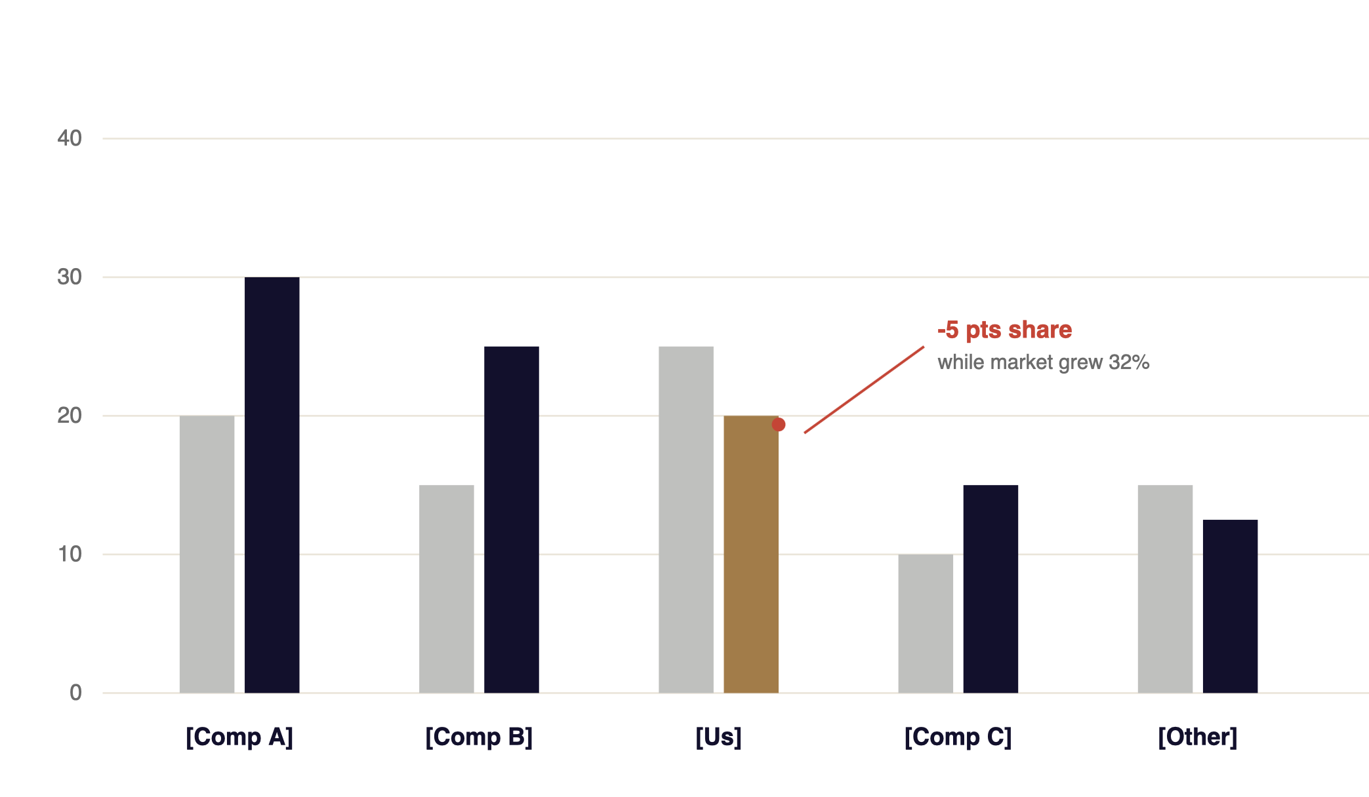
MARKET CONTEXT
[Market is growing at ~XX% — and we are losing ground to two players]
[Top-5 share of [Segment] in [Region], FY2021 – FY2025.]
MARKET SHARE, %
FY2021 → FY2025
SO WHAT
[Headline implication of the chart in one sentence — what the audience should conclude.]
THREE THINGS TO NOTICE
[Pattern #1] — [evidence].
[Pattern #2] — [evidence].
[Pattern #3] — [evidence].
FY2021
FY2025
Our position
Source: [Market intelligence provider, FY2025]; OSK analysis. Shares rebased to top-5.
01 · CONTEXT
09 / 64

Slide 10
BUSINESS IMPACT
[A single number, in plain language, with the implication]
VS. INTERNAL TARGET
[−X.X pts]
[XX]%
[Target was XX% by end of FY25.]
VS. PEER BENCHMARK
[~XX%]
[Median of [3 named peers].]
VS. HISTORICAL TREND
[reversal of X-year trend]
[Plain-language statement of what this number represents in this business.]
[Was improving until FY2024.]
[Definition · period · scope]
WHY IT MATTERS
[The decision-relevant implication of this number — what changes in the business if it stays at this level.]
Source: [Internal management accounts, FY2025]. Peer set: [Comp A, Comp B, Comp C].
01 · CONTEXT
10 / 64

Slide 11
SCOPE & CONSTRAINTS
What this decision covers — and what it does not
IN SCOPE
⊘ OUT OF SCOPE
[Decision area #1] — [what is being decided].
[Adjacent topic #1] — [why excluded; where it will be handled].
[Decision area #2] — [what is being decided].
[Adjacent topic #2] — [why excluded].
[Decision area #3] — [what is being decided].
[Adjacent topic #3] — [why excluded].
[Decision area #4] — [what is being decided].
HARD CONSTRAINTS WE MUST HONOUR
CONSTRAINT
DETAIL
IMPLICATION
Budget
[Max approved envelope]
[How it shapes the option set.]
Timing
[Latest acceptable launch window]
[Phases that must complete by Q3.]
Regulatory
[Approval bodies and dependencies]
[Gates that block subsequent work.]
Risk tolerance
[Board-approved appetite statement]
[Options outside appetite are excluded.]
01 · CONTEXT
11 / 64

Slide 12
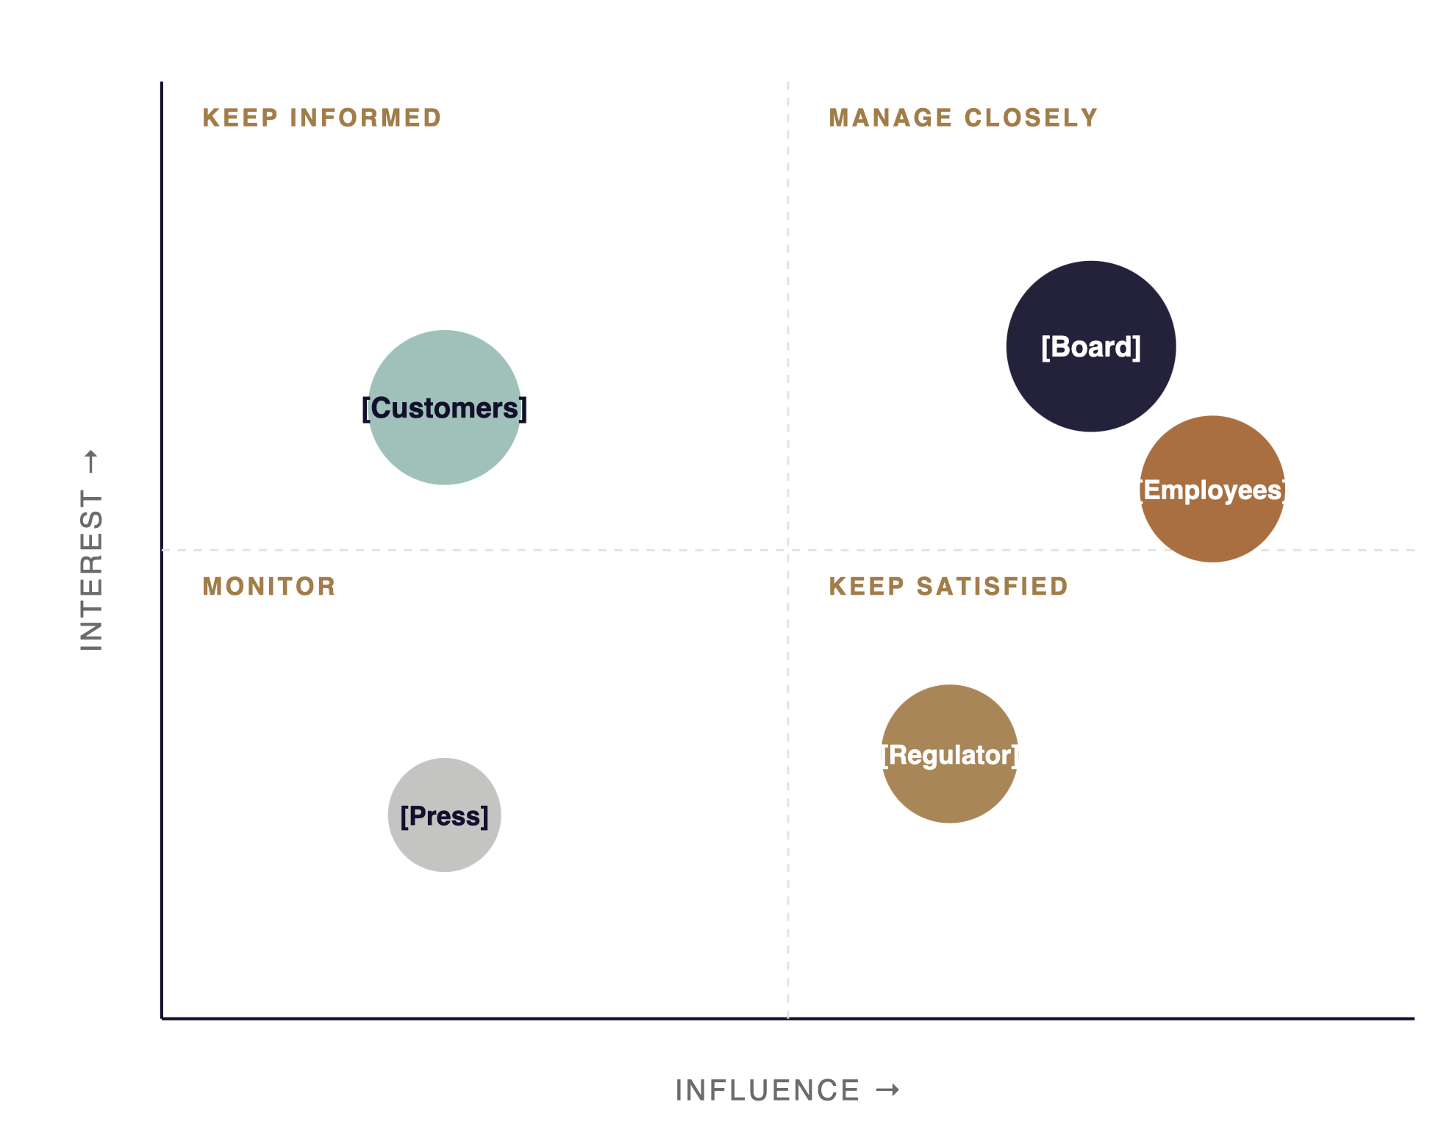
STAKEHOLDER MAP
[Four stakeholder groups will determine whether this lands]
ENGAGEMENT PLAN
[Board]
[Pre-read 5 days out · 1:1 with chair · written Q&A pack.]
[Regulator]
[Quarterly briefing · advance disclosure of milestones.]
[Customers]
[Segment-specific messaging · NPS read pre- and post-launch.]
[Employees]
[Town hall in week of decision · weekly cascade thereafter.]
01 · CONTEXT
12 / 64

Slide 13
02
Diagnosis
What the analysis revealed about root cause, drivers, and the size of the gap.
01 · CONTEXT
·
02 · DIAGNOSIS
·
03 · OPTIONS
·
04 · RECOMMENDATION
·
05 · ROADMAP
·
06 · ASK
13 / 64

Slide 14
KEY INSIGHT
[The single most important thing we learned — stated as an implication, not a fact]
[Subhead: one sentence on the evidence that supports the insight.]
INSIGHT
[INSIGHT VISUAL · CHART, MAP, OR DIAGRAM]
[Restate the insight in plain language — what changes about how we should think.]
THREE PIECES OF EVIDENCE
[Evidence #1] — [observation + number].
[Evidence #2] — [observation + number].
[Evidence #3] — [observation + number].
WHAT IT IMPLIES
[One sentence on what the insight means for the recommendation we will land on.]
02 · DIAGNOSIS
14 / 64

Slide 15
ROOT-CAUSE ANALYSIS
[Performance gap decomposes into four drivers — two account for ~80%]
Source: [Internal driver-tree analysis, FY2025]. Contributions sum to ~100% with rounding.
02 · DIAGNOSIS
15 / 64

Slide 16
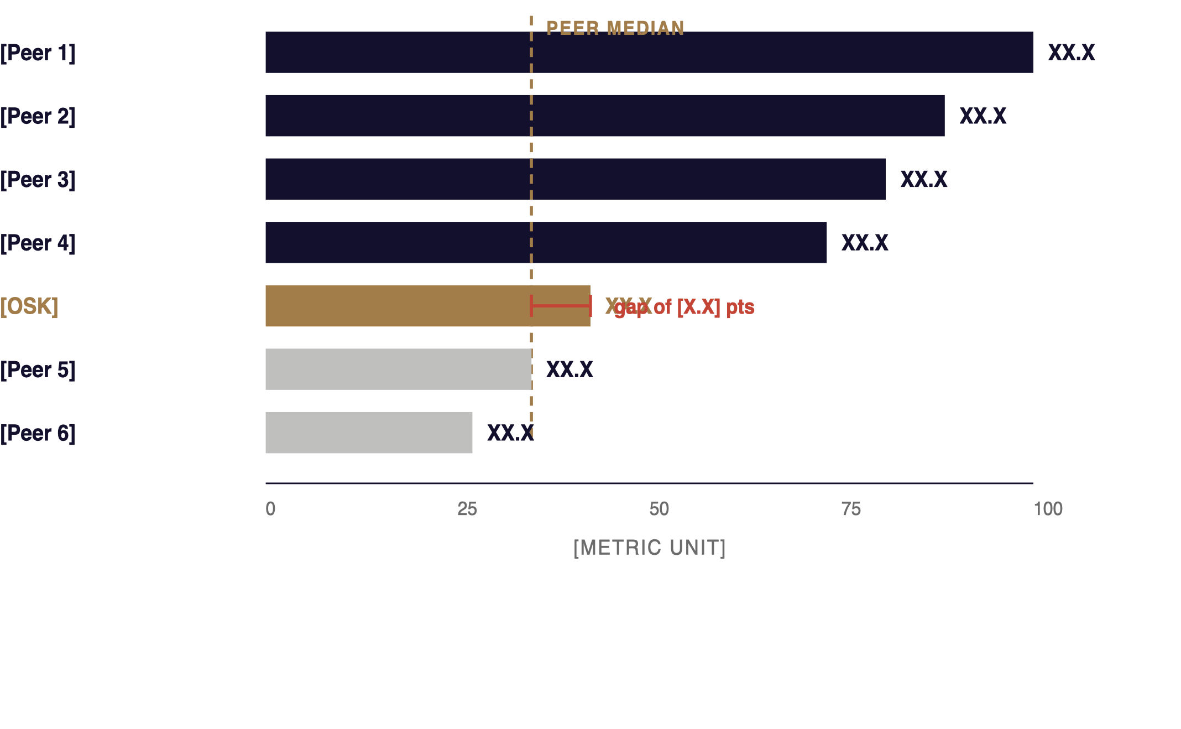
BENCHMARK
[We trail the peer median on the metric that matters most]
[Metric] across [N] named peers, FY2025. Sorted high → low.
SO WHAT
[The gap is not a fluke — it has persisted for [N] periods, even when we adjust for [scale / mix / geography].]
CLOSING IT IS WORTH
[≈ RM XXm]
[in annualised [revenue/EBITDA/cost] if we move to peer-median performance.]
Source: [Annual reports, broker estimates]. Peer set: [list]. Metric defined as [definition].
02 · DIAGNOSIS
16 / 64

Slide 17
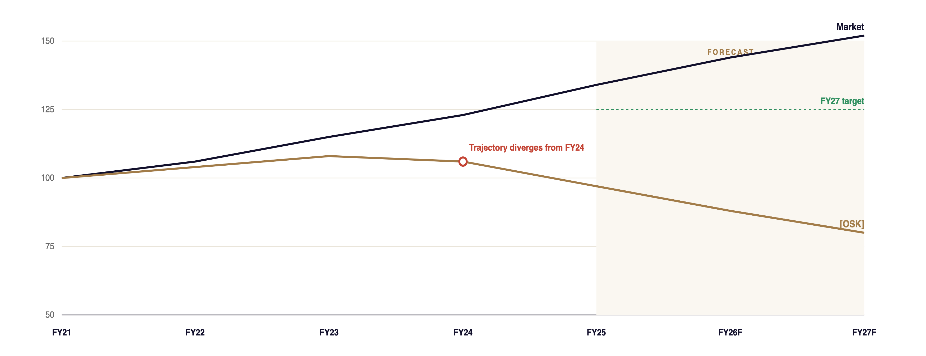
TREND
[Our trajectory diverged from the market in FY2024 — and the gap is widening]
Source: [Bursa filings, OSK analysis]. Index FY2021 = 100. Forecast based on current run-rate; no intervention.
02 · DIAGNOSIS
17 / 64

Slide 18
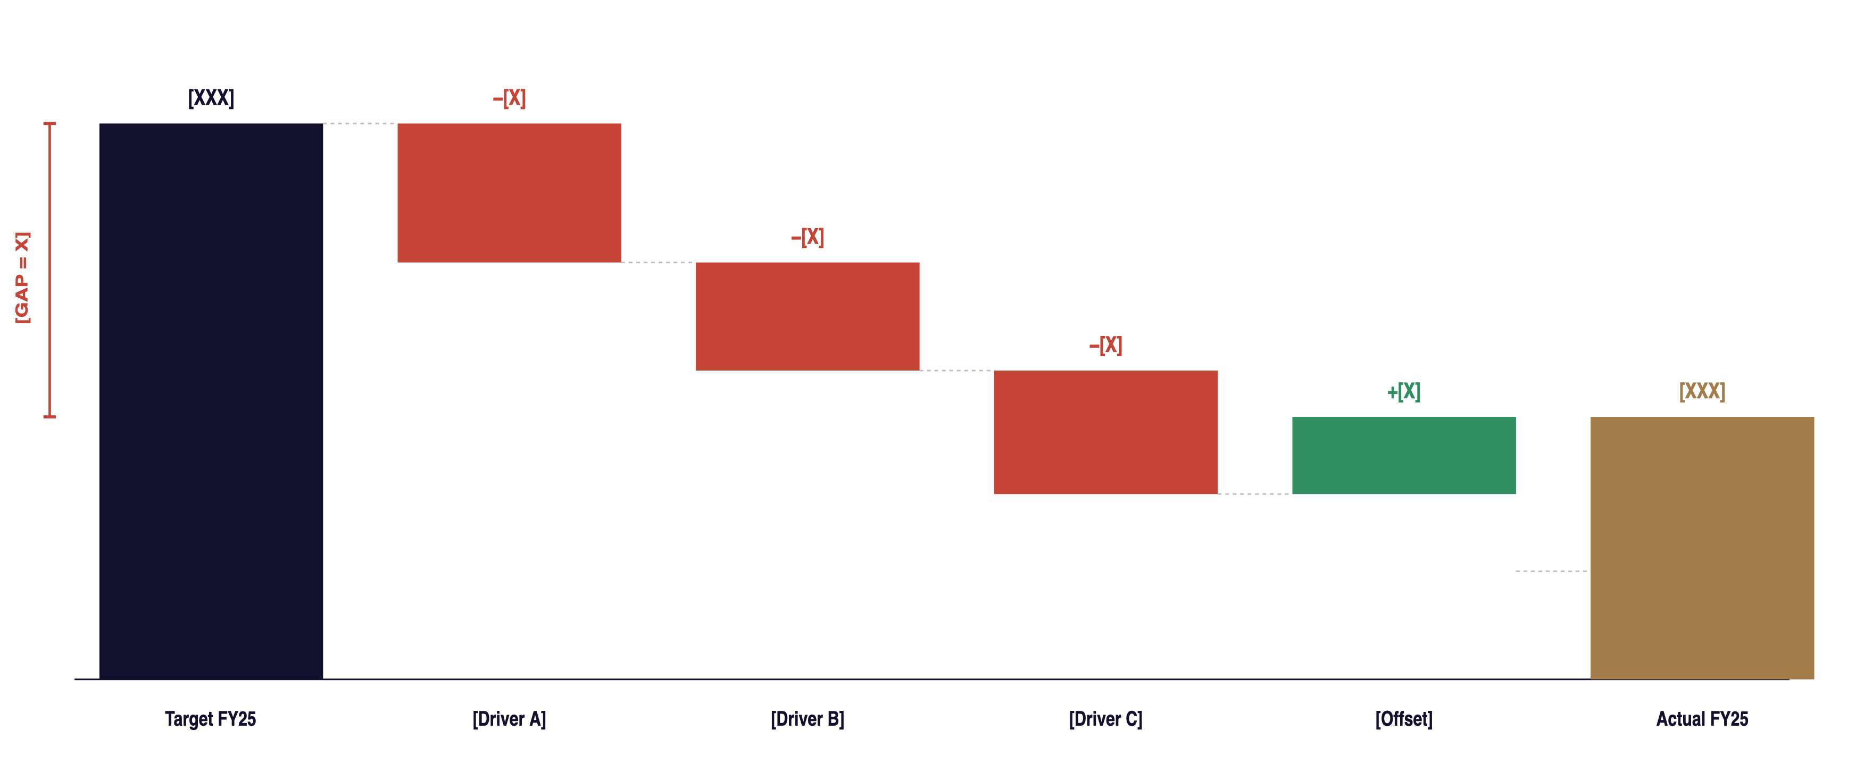
GAP DECOMPOSITION
[Three buckets explain ~85% of the gap between target and actual]
Source: [Internal P&L analysis, FY2025]. Negative bars indicate adverse contribution to the gap; offset is the single favourable item.
02 · DIAGNOSIS
18 / 64

Slide 19
SIDE-BY-SIDE
[Three areas where we and the market are not aligned — and one where we lead]
DIMENSION
WHERE OSK IS TODAY
MARKET / PEER NORM
DIRECTION
READ
[Dimension 1] [definition]
[Our position in one phrase]
[Peer norm in one phrase]
[Widening / Narrowing]
Risk
[Dimension 2] [definition]
[Our position]
[Peer norm]
[Widening]
Risk
[Dimension 3] [definition]
[Our position]
[Peer norm]
[Stable]
Watch
[Dimension 4] [definition]
[Our position]
[Peer norm]
[Narrowing]
Watch
[Dimension 5] [definition]
[Our advantage]
[Peer norm]
[Improving]
Strength
Source: [Internal benchmarking, FY2025]. Direction reflects 3-year trend in gap-to-peer.
02 · DIAGNOSIS
19 / 64

Slide 20
03
Strategic Options
The choice set we evaluated, the criteria we used, and the tradeoffs the leadership team should weigh.
01 · CONTEXT
·
02 · DIAGNOSIS
·
03 · OPTIONS
·
04 · RECOMMENDATION
·
05 · ROADMAP
·
06 · ASK
20 / 64

Slide 21
CHOICE SET
Three credible options — each with a different risk-return profile
All other paths considered were eliminated against the criteria on the next page.
RECOMMENDED
OPTION A
OPTION B
OPTION C
[Hold & optimise]
[Reposition & invest]
[Transformative bet]
[One-line description: what we would do, where we would do it, who would lead.]
[One-line description: the proposed path.]
[One-line description: the boldest path on the table.]
INVESTMENT
PAYBACK
INVESTMENT
PAYBACK
INVESTMENT
PAYBACK
[RM XXm]
[X yrs]
[RM XXm]
[X yrs]
[RM XXXm]
[X+ yrs]
3-YR NPV
RISK
3-YR NPV
RISK
3-YR NPV
RISK
[RM XXm]
Low
[RM XXXm]
Moderate
[RM XXXm]
High
03 · OPTIONS
21 / 64

Slide 22
EVALUATION
Option B scores highest on the criteria we agreed up front
[Scoring: ●●● strong · ●● adequate · ● weak. Weights set with the steering committee on [date].]
CRITERION
WEIGHT
A · HOLD & OPTIMISE
B · REPOSITION & INVEST
C · TRANSFORMATIVE BET
NOTES
[Strategic fit]
20%
● ●
● ● ●
● ● ●
[Alignment with FY26-30 plan.]
[3-yr value creation]
25%
●
● ● ●
● ● ●
[NPV at [discount rate]%.]
[Execution risk]
20%
● ● ●
● ●
●
[Higher score = less risk.]
[Capital intensity]
15%
● ● ●
● ●
●
[Cash requirement vs envelope.]
[Time to impact]
10%
● ● ●
● ●
●
[Quarters to material P&L impact.]
[Stakeholder support]
10%
● ●
● ● ●
●
[Board, regulator, employee read.]
Weighted score
100%
2.1
2.6
2.0
[Out of 3.0.]
03 · OPTIONS
22 / 64

Slide 23
TRADEOFFS
The honest case for and against each option
OPTION A · HOLD & OPTIMISE
OPTION B · REPOSITION & INVEST
OPTION C · TRANSFORMATIVE BET
FOR
FOR
FOR
[Lowest cash outlay, minimal disruption.]
[Builds on capabilities we already have.]
[Easy to reverse if conditions change.]
[Closes ~70% of the diagnosed gap by FY28.]
[Within capital envelope and risk appetite.]
[Phased — early gates allow course-correction.]
[Largest upside if it works.]
[Resets the strategic narrative externally.]
AGAINST
AGAINST
AGAINST
[Outside current risk appetite — board reset needed.]
[Two new capabilities have to land simultaneously.]
[Long time to impact; high reversal cost.]
[Does not address root cause from diagnosis.]
[Gap to peers continues to widen.]
[Loses option value if competitor moves first.]
[Requires [N] senior hires within 6 months.]
[Dependent on regulatory sign-off in Q2.]
03 · OPTIONS
23 / 64

Slide 24
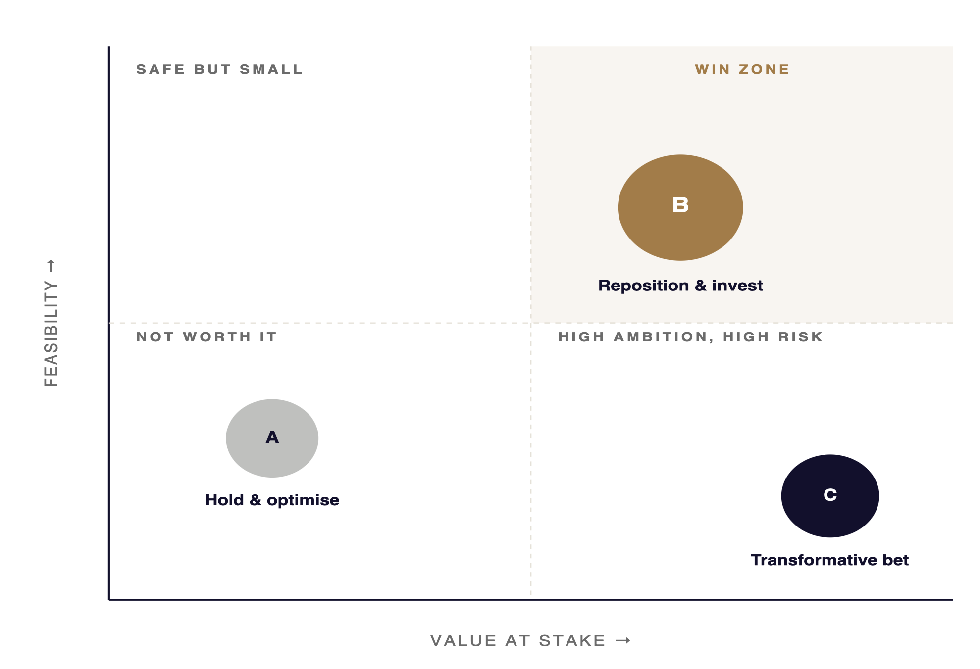
STRATEGIC POSITIONING
Plotted against the two dimensions that matter most, only Option B sits in the win zone
READ
[Option B is the only choice that sits in the upper-right quadrant: meaningful upside with feasibility we can underwrite today.]
WHY THE AXES
Value at stake = 3-yr risk-adjusted NPV against the do-nothing case. Feasibility = composite of capital fit, capability readiness, and stakeholder support.
03 · OPTIONS
24 / 64

Slide 25
04
Recommendation
What we propose, why this option, what success looks like, and the risks we will manage.
01 · CONTEXT
·
02 · DIAGNOSIS
·
03 · OPTIONS
·
04 · RECOMMENDATION
·
05 · ROADMAP
·
06 · ASK
25 / 64

Slide 26
OUR RECOMMENDATION
Pursue Option B — Reposition & invest, starting in [Q3 FY26].
[One-paragraph elaboration: the shape of the move, the order of operations, and the time horizon over which we will measure success.]
SCOPE
INVESTMENT
HORIZON
[Two business units, three markets] — [one-line elaboration].
[RM XXm over 3 years] — [phased; gated; revisable at each gate].
[3 years to full run-rate] — [first impact visible in Q4 FY26].
04 · RECOMMENDATION
26 / 64

Slide 27
WHY THIS OPTION
Three reasons we are confident this is the right call
01
[Addresses the root cause we identified in diagnosis]
[Specifically, it targets Drivers A and B, which together account for ~80% of the gap. The other options leave Driver A untouched.]
02
[Stays within the capital envelope and risk appetite]
[Total investment of [RM XXm] is within the [RM XXm] envelope. Risk profile is consistent with the appetite statement reaffirmed in the [date] board meeting.]
03
[Reversible at well-defined gates — we are not locked in]
[Three formal gates at month 6, 12, and 18. At each gate, we can scale, hold, or unwind based on pre-agreed KPIs.]
04 · RECOMMENDATION
27 / 64

Slide 28
EXPECTED IMPACT
[What success looks like in numbers — by end of FY28]
[METRIC · REVENUE]
[METRIC · MARGIN]
[METRIC · SHARE]
3-YEAR NPV
+[XX]%
+[XX]bps
+[X]pts
RM [XXX]m
CAGR over the period vs. [+X%] in the base case
Expansion vs. FY25 through [mechanism].
Market share gain in [target segment].
Risk-adjusted at [X%] WACC vs. [RM XXm] for Option A.
READING THESE NUMBERS
All four KPIs are measured against an FY2025 baseline and the same forecast horizon. Sensitivities are in the appendix.
Source: [Strategic plan model, FY2026]. Sensitivities ±[X]% on volume, ±[X]% on mix. See Appendix p. [XX].
04 · RECOMMENDATION
28 / 64

Slide 29
RISKS & MITIGATIONS
[Five material risks — each has a named owner and a defined trigger]
RISK
LIKELIHOOD
IMPACT
MITIGATION
TRIGGER / EARLY WARNING
OWNER
[Risk 1 · Regulatory delay]
Med
High
[Pre-engage regulator in [Q1] · provide draft framework · parallel-track approvals.]
[Slip in submission gate by > 2 weeks.]
[CRO]
[Risk 2 · Capability gap]
High
Med
[Targeted senior hires · interim partner with [firm] · in-house academy stream.]
[Hiring < 60% on plan by month 4.]
[CPO]
[Risk 3 · Competitor pre-emption]
Med
Med
[Compressed pilot in [market] · narrowed scope of phase 1 · stronger anchor partner.]
[Competitor launches similar offer in < 2 quarters.]
[CCO]
[Risk 4 · Cost overrun]
Med
Med
[Quarterly stage-gate review with CFO · 15% contingency held centrally · fixed-fee vendor structure.]
[Forecast spend > envelope at gate 1.]
[CFO]
[Risk 5 · Reputational exposure]
Low
High
[Customer comms plan signed off ahead of launch · proactive press strategy · scenario rehearsal.]
[NPS in pilot drops > 5 points.]
[CMO]
04 · RECOMMENDATION
29 / 64

Slide 30
STRATEGIC POSTURE
SWOT — what we bring to this move and what we have to manage
STRENGTHS
WEAKNESSES
[Capability or asset that supports the move.]
[Existing customer / channel advantage.]
[Balance-sheet strength to fund the investment.]
[Capability gap we will need to close.]
[Process or systems debt that slows execution.]
[Talent depth in [discipline].]
OPPORTUNITIES
THREATS
[External shift that creates a tailwind.]
[Adjacent customer need we can serve.]
[Regulatory or policy opening.]
[Competitor move that erodes the window.]
[Macro or FX scenario that compresses returns.]
[Substitute product / channel.]
04 · RECOMMENDATION
30 / 64

Slide 31
05
Roadmap
How we deliver — phases, workstreams, milestones and accountabilities.
01 · CONTEXT
·
02 · DIAGNOSIS
·
03 · OPTIONS
·
04 · RECOMMENDATION
·
05 · ROADMAP
·
06 · CORPORATE EXERCISE
·
07 · INDUSTRY & MARKET
·
08 · ASK
31 / 64

Slide 32
DELIVERY ROADMAP
A four-phase plan — diagnose, design, deliver, scale — across [24] months
1
M0–M3
2
M4–M9
3
M10–M18
4
M19–M24
Mobilise & diagnose
Design the operating model
Deliver pilot, then expand
Scale & embed
Stand up programme office, baseline KPIs, finalise scope, secure quick wins.
Design future-state processes, capability blueprint, partner shortlist, tech architecture.
Launch in [lead market], stabilise, then roll out to [next two markets] in waves.
Full rollout, hand-off to BAU, retire programme overheads, lock in BAU governance.
KEY DELIVERABLES
KEY DELIVERABLES
KEY DELIVERABLES
KEY DELIVERABLES
[Programme charter signed]
[Baseline KPI dashboard]
[Quick-win backlog]
[Target operating model]
[Partner agreements]
[Tech architecture]
[Pilot live in lead market]
[Wave-2 launch readiness]
[NPS & unit-economics proven]
[Full rollout complete]
[BAU handover signed]
[Benefits realisation report]
05 · ROADMAP
32 / 64

Slide 33
WORKSTREAM SCHEDULE
Six workstreams sequenced over [12] months, with two go/no-go gates
WORKSTREAM
M1
M2
M3
M4
M5
M6
M7
M8
M9
M10
M11
M12
WS1 · Programme office
Continuous
WS2 · Operating model
Design
Deploy
WS3 · Technology
Architect
Build & integrate
Hyper-care
WS4 · Talent & capability
Hire & onboard
Academy & uplift
WS5 · Commercial / GTM
Propositions
Launch waves
WS6 · Change & comms
Engage · enable · embed
Build / design
Deploy / scale
Continuous
Stage gate
Months are indicative; final schedule subject to gate-1 sign-off. See appendix for resource loading.
05 · ROADMAP
33 / 64

Slide 34
KEY MILESTONES
Eight checkpoints the executive will see — each has a named owner and a hard date
#
DATE
MILESTONE
DELIVERABLE
OWNER
STATUS
M1
[Mar 2026]
Programme mobilisation complete
[PMO charter, RACI]
[CSO]
On
M2
[May 2026]
Diagnosis & baseline signed off
[Baseline KPI pack]
[CFO]
On
M3
[Aug 2026]
Target operating model approved by Board
[TOM blueprint]
[CSO]
Watch
M4
[Oct 2026]
Tech architecture & vendor selection complete
[Architecture decision record]
[CTO]
Watch
M5
[Dec 2026]
Gate 1 — Go / no-go for pilot
[Stage-gate paper]
[CEO]
Watch
M6
[Mar 2027]
Pilot live in [lead market]
[Pilot readiness review]
[CCO]
Watch
M7
[Sep 2027]
Gate 2 — Scale to waves 2 & 3
[Scale-up paper]
[CEO]
Watch
M8
[Mar 2028]
Full rollout complete; BAU handover
[Benefits realisation report]
[COO]
Watch
05 · ROADMAP
34 / 64

Slide 35
ACCOUNTABILITIES
RACI — one accountable owner per workstream; the executive sponsor consults across the board
WORKSTREAM
CEO
CSO
CFO
COO
CTO
CHRO
CCO
CRO
WS1 · Programme office
A
R
C
C
I
I
I
C
WS2 · Operating model
I
A
C
R
C
C
I
I
WS3 · Technology
I
C
C
C
A
I
C
R
WS4 · Talent & capability
I
C
I
C
I
A
I
I
WS5 · Commercial / GTM
I
C
C
I
I
I
A
C
WS6 · Change & comms
C
R
I
C
I
A
C
I
R Responsible — does the work
A Accountable — single owner
C Consulted — two-way input
I Informed — kept aware
05 · ROADMAP
35 / 64

Slide 36
PROGRAMME TEAM
A single accountable owner, a six-person leadership team, and dedicated workstream squads
05 · ROADMAP
36 / 64

Slide 37
06
Corporate Exercise
Inorganic options — M&A, joint venture, strategic partnership — and how we underwrite them.
01 · CONTEXT
·
02 · DIAGNOSIS
·
03 · OPTIONS
·
04 · RECOMMENDATION
·
05 · ROADMAP
·
06 · CORPORATE EXERCISE
·
07 · INDUSTRY & MARKET
·
08 · ASK
37 / 64

Slide 38
STRATEGIC RATIONALE
A transaction makes sense only if it does at least one of four things — and ideally three
01
02
03
04
Accelerate strategy
Acquire capability
Enter or scale a market
Capture synergies
[Compresses [X] years of organic build into [Y] months — buying time, not just assets.]
[Brings in [specific capability / IP / talent] we cannot build economically in-house.]
[Gives immediate access to [geography / segment] with established channel and licences.]
[Cost & revenue synergies of [RM XX m] NPV — see synergy waterfall, p.41.]
OUR TEST
[The deal must clear all three: strategic fit · synergy clarity · post-close governability. Anything failing one of these is not pursued.]
06 · CORPORATE EXERCISE
38 / 64

Slide 39
TARGET SCREEN
From a long list of [24], six candidates clear the strategic filter — three are go-to-market priorities
CANDIDATE
GEOGRAPHY
STRATEGIC FIT
FINANCIAL PROFILE
SYNERGY POTENTIAL
INTEGRATION RISK
OVERALL
ACTION
[Target A]
[Malaysia]
High
High
High
Med
★ ★ ★ ★ ★
[Approach — priority 1]
[Target B]
[Indonesia]
High
Med
High
Med
★ ★ ★ ★ ☆
[Approach — priority 2]
[Target C]
[Singapore]
High
High
Med
Low
★ ★ ★ ★ ☆
[Approach — priority 3]
[Target D]
[Thailand]
Med
High
Med
Med
★ ★ ★ ☆ ☆
[Watch — JV first]
[Target E]
[Vietnam]
Med
Med
High
High
★ ★ ☆ ☆ ☆
[Hold]
[Target F]
[Philippines]
Med
Med
Med
High
★ ★ ☆ ☆ ☆
[Hold]
Screening criteria: revenue [>RM XXm], EBITDA margin [>XX%], strategic adjacency, governance fit. Detailed scorecards in appendix.
06 · CORPORATE EXERCISE
39 / 64

Slide 40
PRIORITY TARGET · PROFILE
[Target A] — [one-line description: what they do, where they play, why they fit]
REVENUE (FY25)
EBITDA MARGIN
HEADCOUNT
[TARGET LOGO / HERO IMAGE]
RM [XXX]m
[XX]%
[X,XXX]
[+XX%] YoY
Peer median [XX]%
[XX]% engineering
OWNERSHIP
[Founder XX%] · [PE fund XX%] · [Management XX%]
GEOGRAPHIES
[Markets served]
PRODUCTS
[Product lines / segments]
WHY THIS ONE
KEY CUSTOMERS
[Anchor accounts; concentration]
[Three lines on why Target A wins on the screen — capability, customer overlap, geographic complementarity.]
REGULATORY STATUS
[Licences held; restrictions]
RECENT ACTIVITY
[Funding rounds, acquisitions, leadership changes in last 24m]
KEY CONCERNS
[Customer concentration, founder retention risk, FX exposure on receivables.]
Source: [Target management presentation], company filings, OSK analysis. All figures unaudited.
06 · CORPORATE EXERCISE
40 / 64

Slide 41
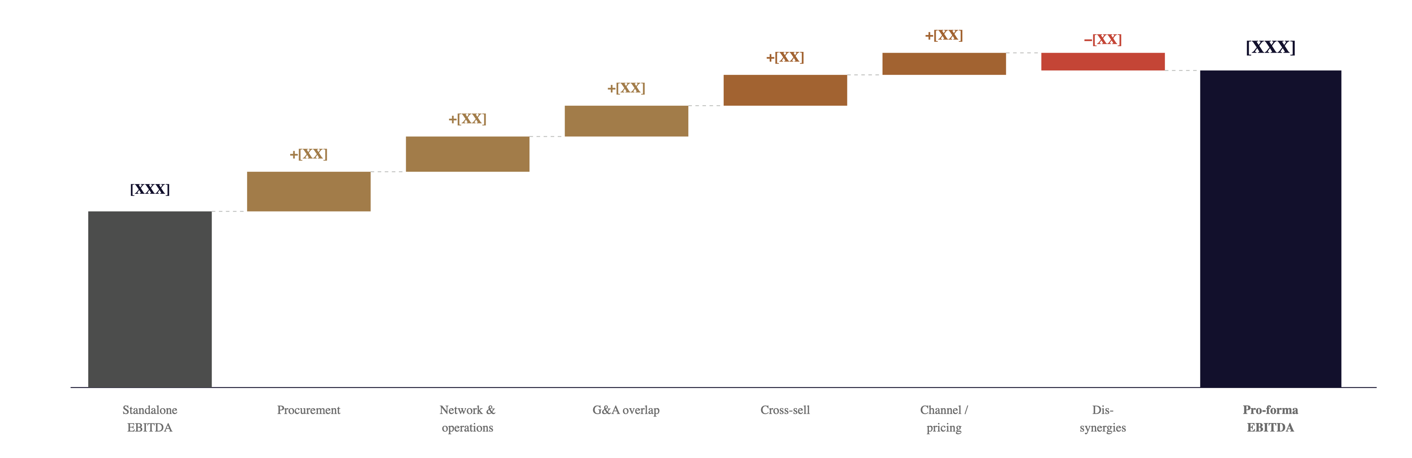
VALUE CREATION
[RM XXX m] of run-rate synergies — two-thirds cost, one-third revenue, net of [RM XX m] dis-synergies
Cost synergy
Revenue synergy
Dis-synergy / cost-to-achieve
Source: OSK synergy model, [v0.3]. Phased to run-rate in [Y3]. Cost to achieve: [RM XX m], paid back in [XX] months.
06 · CORPORATE EXERCISE
41 / 64

Slide 42
VALUATION RANGE
Five methodologies bracket equity value at [RM XXX–YYY m] — anchor on DCF, sense-check on comps
METHODOLOGY
RANGE (RM M, EQUITY VALUE)
RANGE
DCF · base case
[420–520]
DCF · upside scenario
[560–700]
Trading comps · EV/EBITDA
[380–580]
Trading comps · EV/Revenue
[460–600]
Precedent transactions
[520–680]
Indicative offer range
[500–580]
Axis: RM 0 m ··· RM 1,000 m
Range
Mid-point
Source: OSK valuation model [v0.3]. DCF: WACC [X.X]%, terminal growth [X.X]%. Comps set: [list]. All values pre-synergy.
06 · CORPORATE EXERCISE
42 / 64

Slide 43
TRANSACTION STRUCTURE
[60%] cash acquisition via a Malaysian SPV — founders retain [40%] with a put/call at year [3]
KEY TERMS
CONSIDERATION
RM [XXX m] · [60%] cash, [40%] roll-over
FUNDING MIX
[60%] cash from balance sheet, [40%] new debt
IMPLIED MULTIPLE
[X.X]× EV/EBITDA · [X.X]× EV/Revenue
LOCK-UP / EARN-OUT
[3-year] earn-out tied to [EBITDA target]
GOVERNANCE
OSK appoints [3] of [5] board seats; reserved matters
CONDITIONS PRECEDENT
[Regulatory] · [shareholder] · [key-man] approvals
TARGET CLOSE
[Q4 FY2026]
Indicative structure subject to legal & tax review. Final structure may use a Labuan / Singapore intermediary depending on dividend repatriation analysis.
06 · CORPORATE EXERCISE
43 / 64

Slide 44
POST-CLOSE INTEGRATION
Day-1 stability, Day-100 momentum, Year-1 synergy — three horizons with clear exit criteria
HORIZON 1 · DAY 1
HORIZON 2 · DAY 100
HORIZON 3 · YEAR 1
Stabilise & reassure
Set the operating rhythm
Deliver the synergies
[Day-1 comms to staff, customers, regulators]
[Retention packages for top [XX] roles]
[IT & data access continuity]
[Integration Management Office stood up]
[Joint scorecard published]
[Combined ELT operating model live]
[First synergy quick-wins captured]
[Single P&L view across entities]
[Joint product / GTM plan signed]
[Cultural integration plan in flight]
[Tech / data migration phase 1 complete]
[Procurement consolidation captured]
[Cross-sell motion in market]
[Org redesign live · attrition managed]
[Integration office wound down]
EXIT CRITERION
EXIT CRITERION
EXIT CRITERION
[No churn of top-20 customers; key-talent retention > 95%.]
[[RM XX m] run-rate synergies banked; integration NPS > [XX].]
[[XX]% of Y3 synergies on run-rate; combined EBITDA on plan.]
06 · CORPORATE EXERCISE
44 / 64

Slide 45
07
Industry & Market
Where the industry is moving, who is competing, how value is priced, and where the openings are.
01 · CONTEXT
·
02 · DIAGNOSIS
·
03 · OPTIONS
·
04 · RECOMMENDATION
·
05 · ROADMAP
·
06 · CORPORATE EXERCISE
·
07 · INDUSTRY & MARKET
·
08 · ASK
45 / 64

Slide 46
INDUSTRY STRUCTURE
Industry attractiveness is moderate — buyer power is the binding constraint, not new entrants
NEW ENTRANTS
[Low — High capital, regulatory and brand barriers protect incumbents.]
[Two new entrants in [3] years, neither at scale. Licence regime is a hard moat.]
LOW
SUPPLIER POWER
INTERNAL RIVALRY
BUYER POWER
[Med — concentrated upstream, but multiple options.]
[High — three credible incumbents]
[High — concentrated enterprise buyers with sophisticated procurement.]
[Top-3 suppliers control [XX]% of input; long-term contracts cushion volatility.]
[Price discipline is fragile; differentiation has moved to service and ecosystem.]
[Top-20 customers = [XX]% of revenue. Multi-year RFPs with switching enabled.]
MEDIUM
High
HIGH
SUBSTITUTES
[Med — adjacent in-house solutions emerging, not yet at parity.]
[Build-vs-buy decisions trending towards buy for now; AI-driven disintermediation a watch-item.]
MEDIUM
Source: OSK industry analysis, FY2025. Intensity scored on a 1–5 scale; methodology in appendix.
07 · INDUSTRY & MARKET
46 / 64

Slide 47
WHERE VALUE SITS
Value is shifting from upstream production toward downstream service and customer relationship
PRIMARY ACTIVITIES
Inbound logistics
Operations
Outbound logistics
Sales & marketing
Service
[Sourcing, intake, supplier mgmt.]
[Production, processing, build.]
[Distribution, fulfilment, delivery.]
[Demand generation, deal closing.]
[Retention, expansion, support.]
~[X]% of cost
~[X]% of cost
~[X]% of cost
~[X]% of cost · highest margin lever
~[X]% of cost · highest LTV lever
SUPPORT ACTIVITIES
Firm infrastructure
Human resource management
Technology & data
Procurement
[Finance, legal, planning.]
[Hiring, capability, retention.]
[Platform, analytics, AI.]
[Strategic sourcing.]
IMPLICATION
[We should redirect investment from operations efficiency to downstream service capability, where margin pools are concentrating.]
07 · INDUSTRY & MARKET
47 / 64

Slide 48
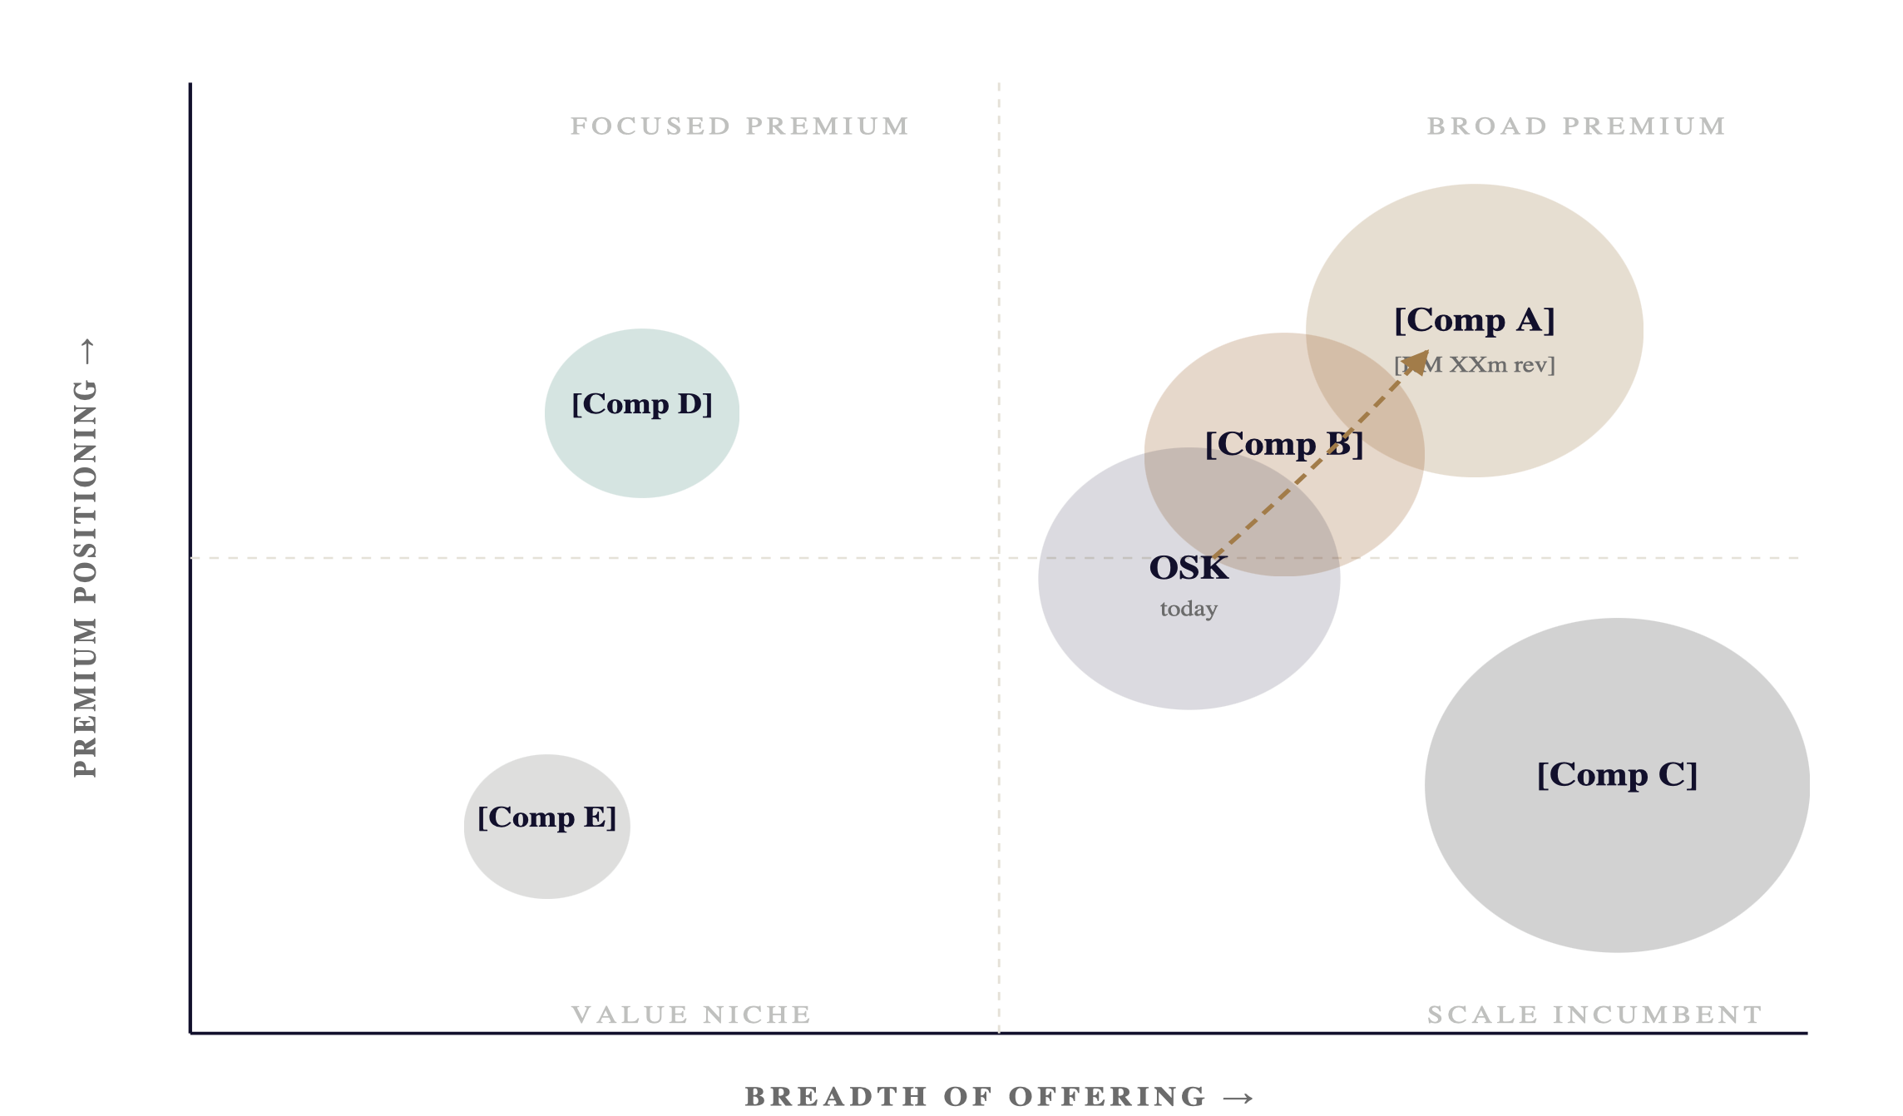
COMPETITIVE LANDSCAPE
The top-right quadrant — broad offering, premium positioning — is contested by two players
WHERE WE PLAY TODAY
[OSK sits mid-breadth, mid-premium — a credible but undifferentiated middle.]
WHERE WE SHOULD HEAD
[Move up and right — broader offering at premium positioning — into the contested top-right quadrant.]
BUBBLE SIZE
Bubble size = [FY25 revenue, RM m]. OSK position is current-state; arrow shows aspiration over the plan horizon.
Source: Company filings, OSK analysis. Positioning is qualitative based on product breadth and average price point.
07 · INDUSTRY & MARKET
48 / 64

Slide 49
COMPETITOR PROFILES
Three competitors deserve close watch — each has a different theory of how to win
[COMPETITOR A]
Top threat
[COMPETITOR B]
Watch
[COMPETITOR C]
Manageable
[Premium ecosystem play]
[Digital-native challenger]
[Scale incumbent — value]
REVENUE (FY25)
3-YR CAGR
REVENUE (FY25)
3-YR CAGR
REVENUE (FY25)
3-YR CAGR
RM [XXX] m
+[XX]%
RM [XXX] m
+[XX]%
RM [XXX] m
+[X]%
STRATEGY
STRATEGY
STRATEGY
[Bundle product + service + financing into long-term contracts; lock customers in via ecosystem.]
[Disrupt at the entry-tier; reach scale via lower cost-to-serve; expand upmarket later.]
[Win on price and ubiquity; defend share via scale rather than innovation.]
STRENGTHS
STRENGTHS
STRENGTHS
[Capital, brand, customer relationships.]
[Tech stack, unit economics, agility.]
[Distribution, cost base, regulatory ties.]
VULNERABILITIES
VULNERABILITIES
VULNERABILITIES
[Slow on AI / digital; weak in emerging markets.]
[Thin balance sheet; no enterprise track record.]
[Stagnant growth; eroding NPS; legacy tech debt.]
Source: Company annual reports, broker research, OSK competitive intelligence. All figures FY2025 unless stated.
07 · INDUSTRY & MARKET
49 / 64

Slide 50
MARKET OPPORTUNITY
A [RM XXX bn] addressable market — but only [RM XX bn] is realistically winnable in five years
TAM
SAM
TOTAL ADDRESSABLE
RM [XXX] bn · TAM
SOM
[All buyers, all geographies — the theoretical ceiling. Growing at [XX]% CAGR through [2030].]
RM [XX] bn
SERVICEABLE ADDRESSABLE
RM [XX] bn · SAM
[Buyers we can reach with our current licences, channels and product fit — [XX]% of TAM.]
[Y5 ambition]
SHARE WE WILL WIN
RM [XX] bn · SOM
[Realistic 5-year capture given capacity, brand and competitive response — [XX]% share of SAM.]
Source: [Market intelligence provider], OSK demand model FY2025. TAM/SAM definitions in appendix; SOM tied to plan-of-record.
07 · INDUSTRY & MARKET
50 / 64

Slide 51
TRADING MULTIPLES
Public comps trade at [X.X]–[Y.Y]× EV/EBITDA — OSK at the low end despite better growth
COMPANY
COUNTRY
MKT CAP (RM M)
REV FY25 (RM M)
REV GROWTH
EBITDA MARGIN
EV / REV
EV / EBITDA
P/E
DIV YIELD
[Listed Peer 1]
[MY]
[X,XXX]
[X,XXX]
+[XX]%
[XX]%
[X.X]×
[XX.X]×
[XX]×
[X.X]%
[Listed Peer 2]
[SG]
[X,XXX]
[X,XXX]
+[XX]%
[XX]%
[X.X]×
[XX.X]×
[XX]×
[X.X]%
[Listed Peer 3]
[TH]
[X,XXX]
[X,XXX]
+[X]%
[XX]%
[X.X]×
[XX.X]×
[XX]×
[X.X]%
[Listed Peer 4]
[ID]
[X,XXX]
[X,XXX]
+[XX]%
[XX]%
[X.X]×
[XX.X]×
[XX]×
[X.X]%
[Listed Peer 5]
[PH]
[X,XXX]
[X,XXX]
+[X]%
[XX]%
[X.X]×
[XX.X]×
[XX]×
[X.X]%
Peer median
—
—
+[XX]%
[XX]%
[X.X]×
[XX.X]×
[XX]×
[X.X]%
OSK Holdings
[MY]
[X,XXX]
[X,XXX]
+[XX]%
[XX]%
[X.X]×
[X.X]×
[XX]×
[X.X]%
IMPLICATION
[We trade at a [X]% discount to the peer median on EV/EBITDA. Re-rating to median multiple implies [RM X.X bn] of equity upside, holding fundamentals constant.]
Source: [Bloomberg, S&P Capital IQ], company filings, OSK analysis. Pricing as at [DD Mmm YYYY]. NTM consensus where available.
07 · INDUSTRY & MARKET
51 / 64

Slide 52
EMERGING TRENDS · PESTEL
Eleven forces will reshape the operating environment — four are high-impact, near-term
FORCE
TREND
HORIZON
IMPACT
DIRECTION
TOP-FOUR TRENDS TO PLAY OFFENSIVELY
[Generative AI] — reshape cost-to-serve and product experience.
Political
[Industrial policy shift toward national champions]
2-3 yr
High
↑ Tailwind
[Industrial policy] — position OSK as a national champion in [sector].
[Climate transition financing] — first-mover advantage on green offerings.
[ASEAN cross-border] — accelerate regional expansion ahead of the framework.
Economic
[Higher cost of capital, FX volatility]
0-1 yr
Med
↓ Headwind
Social
[Customer expectations on service speed and digital UX]
0-2 yr
High
↑ Forces action
WATCH-ITEMS
[Cost of capital & FX · physical climate risk on regional assets · AI regulation in financial services.]
Technological
[Generative AI in operations & customer service]
0-2 yr
Very high
↑ Disruptive
Technological
[Cloud / data platform consolidation]
2-3 yr
Med
↑ Neutral
Environmental
[Climate disclosure & transition financing requirements]
2-4 yr
High
↑ Tailwind for prepared firms
Environmental
[Physical climate risk on assets / supply chain]
3-5 yr
Med
↓ Headwind
Legal
[Data protection & AI regulation tightening]
0-1 yr
Med
↑ Forces action
Legal
[ASEAN cross-border services framework]
2-3 yr
Med
↑ Tailwind
Demographic
[Ageing customer cohorts in core markets]
3-5 yr
Low
↓ Slow drag
07 · INDUSTRY & MARKET
52 / 64
Geopolitical
[Supply-chain reshoring within ASEAN]
2-3 yr
High
↑ Tailwind

Slide 53
OPPORTUNITIES & CHALLENGES
Five openings worth playing for; five challenges we must actively manage
OPPORTUNITIES
CHALLENGES
01
[Regional ASEAN expansion] [RM XX bn] addressable, low OSK presence today.
01
[Talent — AI / data capability] Hot market; build-vs-acquire-vs-partner trade-off.
02
[AI-led service transformation] [XX]% cost-to-serve reduction at parity NPS.
02
[Cost of capital] Hurdle rate up [XX]bps; tightens deal economics.
03
[Green / transition products] First-mover advantage in [sub-segment].
03
[Regulatory shifts] Data, AI, climate disclosure — compounding.
04
[Inorganic — Target A] Capability, customer and geographic complementarity.
04
[Competitor pre-emption] [Competitor A] capable of matching our move at scale.
05
[Premium service tier] Untapped willingness-to-pay among top [XX]% of customers.
05
[Execution bandwidth] Concurrent transformation + M&A stretches leadership.
07 · INDUSTRY & MARKET
53 / 64

Slide 54
08
Ask
What we need from this audience to move forward — decisions, capital, next steps.
01 · CONTEXT
·
02 · DIAGNOSIS
·
03 · OPTIONS
·
04 · RECOMMENDATION
·
05 · ROADMAP
·
06 · CORPORATE EXERCISE
·
07 · INDUSTRY & MARKET
·
08 · ASK
54 / 64

Slide 55
DECISIONS REQUIRED TODAY
Four explicit decisions — each with a decision-maker, a deadline, and a consequence of delay
#
DECISION
DECISION-MAKER
DEADLINE
IF WE DELAY
01
Approve the recommended option and authorise full programme funding of [RM XXX m].
[Board]
[Today]
[6-month slip; competitor window closes.]
02
Approve approach to [Target A] with non-binding offer at [RM XXX m].
[Board investment committee]
[End Q2]
[Target enters discussion with [Competitor A].]
03
Endorse the proposed operating-model changes and headcount envelope.
[CEO + CHRO]
[End Q2]
[Capability gap widens; hiring season missed.]
04
Confirm executive sponsor and named programme lead.
[CEO]
[Within 2 weeks]
[Mobilisation drifts; gate-1 at risk.]
WHAT WE ARE NOT ASKING
[We are not seeking a decision on detailed tech vendor selection, target country sequencing beyond market 1, or final transaction structure — those return at gate 1.]
08 · ASK
55 / 64

Slide 56
INVESTMENT ASK
RM [XXX] m over [3] years — recovered in [year 4] and creating [RM X.X bn] NPV through year [10]
RM [XXX] million · total programme
CAPITAL DEPLOYMENT BY CATEGORY & PHASE
CATEGORY
FY26
FY27
FY28
TOTAL
Technology & platform
[XX]
[XX]
[XX]
[XXX]
Talent & capability
[XX]
[XX]
[XX]
[XXX]
Inorganic — Target A
[XXX]
[—]
[—]
[XXX]
Commercial / GTM
[XX]
[XX]
[XX]
[XXX]
Change & programme office
[XX]
[XX]
[XX]
[XXX]
TOTAL
[XXX]
[XXX]
[XXX]
[XXX]
PAYBACK
IRR
10-YR NPV
All figures in RM millions. Funding mix: [60%] internal cash, [40%] new debt facility. Detailed cash-flow model in appendix.
[3.8] yr
[XX]%
RM [X.X] bn
08 · ASK
56 / 64

Slide 57
NEXT 90 DAYS
Three sprints, twelve actions — by day 90 the programme is funded, staffed and moving
FIRST 30 DAYS
DAY 30–60
DAY 60–90
Mobilise
Diagnose & scope
Mobilise delivery
[Programme charter signed]
[Executive sponsor & lead named]
[Steering committee stood up]
[Funding gate cleared]
[Baseline KPI dashboard live]
[Approach letter sent to Target A]
[Workstream leads hired / assigned]
[Quick-win backlog approved]
[Tech architecture decisions logged]
[Target A — heads of terms drafted]
[Comms & change plan in market]
[Gate-1 readiness check]
OWNER
OWNER
OWNER
[CEO]
[CSO]
[Programme lead]
08 · ASK
57 / 64

Slide 58
“
[The window for this move is open now and will close within twenty-four months. The cost of waiting is bigger than the cost of being wrong.]
[Name Surname]
[Title · Organisation]
58 / 64

Slide 59
Thank you
[One closing sentence — what you want the room to do after they leave.]
PROGRAMME LEAD
STRATEGY
FINANCE
[Name Surname]
[Name Surname]
[Name Surname]
[ email@osk.com ]
[ email@osk.com ]
[ email@osk.com ]
[+60 XX XXX XXXX]
[+60 XX XXX XXXX]
[+60 XX XXX XXXX]
59 / 64

Slide 60
A
Appendix
Methodology, detailed financials, assumptions and definitions for the analyses presented.
A1 · METHODOLOGY
·
A2 · DETAILED FINANCIALS
·
A3 · ASSUMPTIONS
·
A4 · GLOSSARY
60 / 64

Slide 61
A1 · METHODOLOGY
How the analyses in this pack were built — inputs, models, validation
DATA SOURCES
VALIDATION
[Internal management accounts FY21–FY25 (audited where applicable)]
[Group reporting database, extracted DD Mmm YYYY]
[Industry intelligence: Bloomberg, S&P Capital IQ, [provider]]
[Customer survey, n=[XXX], fielded Q[X] FY25]
[Expert interviews, n=[XX] across [domains]]
[Internal stress-tests with [Finance, Risk, COO office]]
[External challenge session with [advisor], [date]]
[Triangulation across top-down and bottom-up sizing]
[Red-team review by [function], [date]]
LIMITATIONS
MODELLING APPROACH
[All target financials unaudited and management-supplied]
[Macroeconomic assumptions held flat at consensus]
[Competitor response modelled at base case only]
[DCF: 10-year explicit forecast, terminal value via Gordon growth]
[Synergy model: bottom-up by lever, run-rate over [3] years]
[Sensitivities: ±[XX]% on volume, ±[XX]bps on margin]
APPENDIX · METHODOLOGY
61 / 64

Slide 62
A2 · PRO-FORMA P&L
Five-year pro-forma · plan of record · all values RM millions
LINE ITEM
FY25A
FY26E
FY27E
FY28E
FY29E
FY30E
CAGR 25–30
Revenue
[X,XXX]
[X,XXX]
[X,XXX]
[X,XXX]
[X,XXX]
[X,XXX]
+[XX]%
Organic
[X,XXX]
[X,XXX]
[X,XXX]
[X,XXX]
[X,XXX]
[X,XXX]
+[X]%
Inorganic (Target A)
—
[XX]
[XXX]
[XXX]
[XXX]
[XXX]
—
Gross profit
[X,XXX]
[X,XXX]
[X,XXX]
[X,XXX]
[X,XXX]
[X,XXX]
+[XX]%
GP margin
[XX]%
[XX]%
[XX]%
[XX]%
[XX]%
[XX]%
—
Operating expenses
([XXX])
([XXX])
([XXX])
([XXX])
([XXX])
([XXX])
+[X]%
EBITDA
[XXX]
[XXX]
[XXX]
[XXX]
[XXX]
[X,XXX]
+[XX]%
EBITDA margin
[XX]%
[XX]%
[XX]%
[XX]%
[XX]%
[XX]%
—
Net profit (NPAT)
[XXX]
[XXX]
[XXX]
[XXX]
[XXX]
[XXX]
+[XX]%
Free cash flow
[XXX]
([XX])
[XX]
[XXX]
[XXX]
[XXX]
—
Capex
([XX])
([XXX])
([XXX])
([XX])
([XX])
([XX])
—
Source: OSK strategic plan model [v0.3], FY2026. A = actuals; E = estimate. Inorganic line assumes deal close [Q4 FY26].
APPENDIX · DETAILED FINANCIALS
62 / 64

Slide 63
A3 · KEY ASSUMPTIONS
Eleven assumptions drive the plan — three are material and watch-listed for early sensitivity testing
#
ASSUMPTION
VALUE
SOURCE
SENSITIVITY
MATERIALITY
1
[Market growth · core segment]
[X.X]% CAGR FY25–30
[Bloomberg]
±[X.X] pp
High
2
[Win-rate uplift from new proposition]
[XX]% → [XX]%
[Customer survey]
±[X] pp
High
3
[Cost-to-serve reduction from AI]
[XX]% by FY28
[Internal pilot]
±[X] pp
High
4
[FX · MYR/USD]
[4.X]
[Treasury]
±[X]%
Med
5
[Cost of debt]
[X.X]%
[Treasury]
±[XX]bps
Med
6
[Headcount ramp]
+[XXX] FTE by FY28
[Plan]
±[XX] FTE
Med
7
[Target A acquisition cost]
RM [XXX] m
[Valuation]
±[XX]%
Med
8
[Synergy realisation · Y3 run-rate]
RM [XX] m
[Synergy model]
±[XX]%
Med
9
[Customer retention · pilot]
[XX]% YoY
[Internal]
±[X] pp
Low
10
[Effective tax rate]
[XX]%
[Finance]
±[X] pp
Low
APPENDIX · ASSUMPTIONS
63 / 64
11
[Terminal growth · DCF]
[X.X]%
[Consensus]
±[X.X] pp
Low

Slide 64
A4 · GLOSSARY
Definitions used throughout this pack
BAU Business-as-usual — steady-state operations after the programme winds down.
NPS Net promoter score — customer-advocacy metric.
CAGR Compound annual growth rate.
RACI Responsibility framework: Responsible, Accountable, Consulted, Informed.
CP (Conditions Precedent) Conditions that must be satisfied before a transaction can close — typically regulatory and shareholder approvals.
SAM Serviceable addressable market — share of TAM reachable with current capabilities.
DCF Discounted cash flow — intrinsic-value approach to valuation.
SOM Serviceable obtainable market — realistic share of SAM we plan to capture.
EBITDA Earnings before interest, tax, depreciation and amortisation.
SPV Special-purpose vehicle — legal entity created to hold and ring-fence a transaction.
EV Enterprise value — equity value plus net debt.
TAM Total addressable market — full demand for a product / category.
FCF Free cash flow — operating cash flow net of capex.
TOM Target operating model — future-state design of how the firm runs.
JV Joint venture — separate legal entity owned by two or more parties.
WACC Weighted-average cost of capital — discount rate used in DCF.
APPENDIX · GLOSSARY
64 / 64

